Slide 1



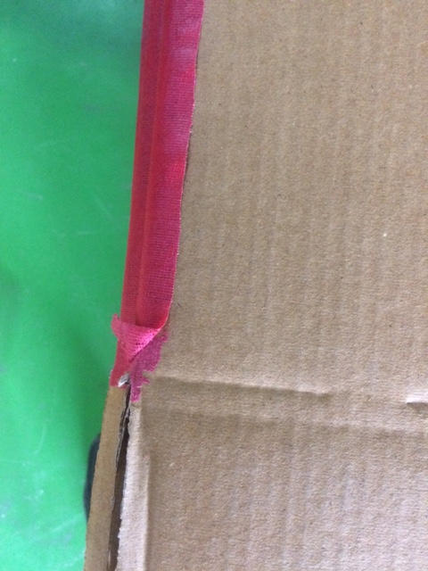
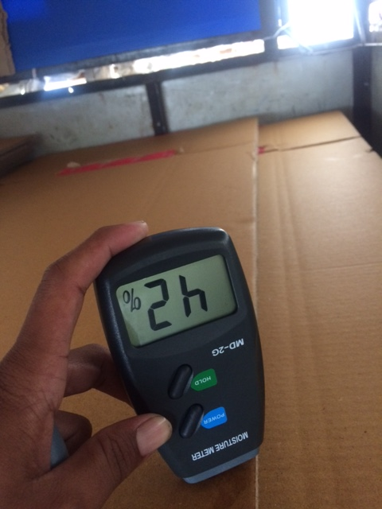
Attributes & variable
Attributes
Variable
As the box pasting is should be good it should not open we judge its quality by visual
Moisture contained in the box is Below 20 % but we allow up to 20-21 %

Slide 2
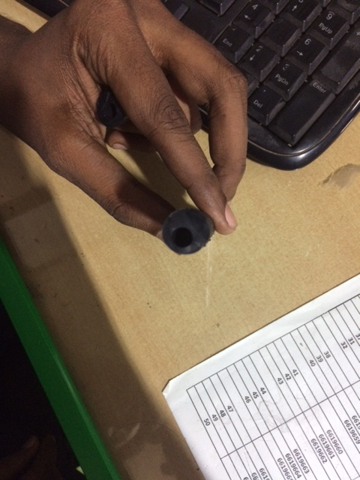
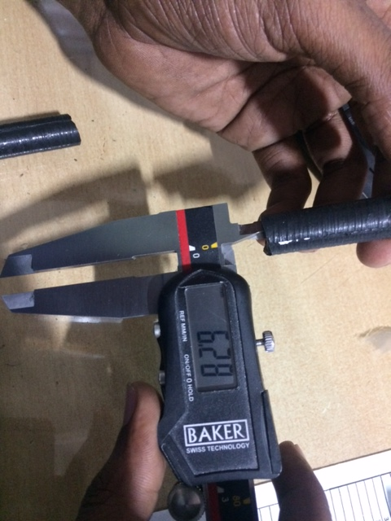
Attributes & variable
Attributes
Variable
During the cap inspection we observed eccentric caps. We judge them according to visual appearance as eccentricity increase the caps are reject
For every cap there is a dimension tolerance for every section like ID, OD, Total length according to the tolerance we inspect them.

Slide 3
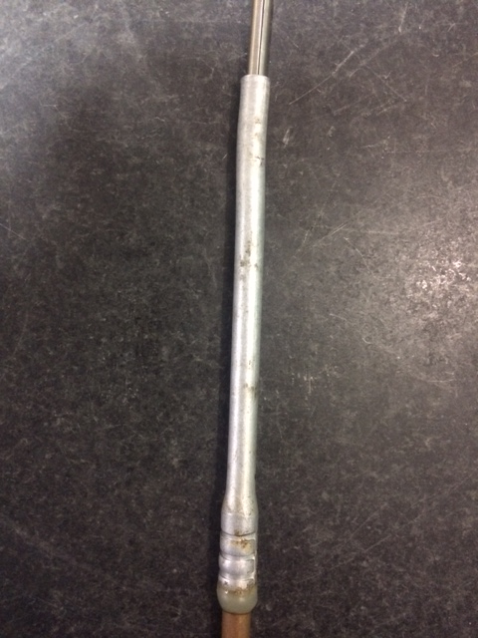
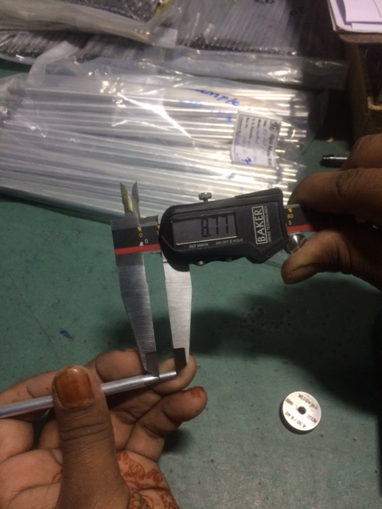
Attributes & variable
Attributes
Variable
The joint raw material should be clean and glue mark free we judge it by visual inspection
For every joint there are specific dimension for every section. like spinning length, taper length ,tube length every one having the specific tolerance according to that we inspect them

Slide 4
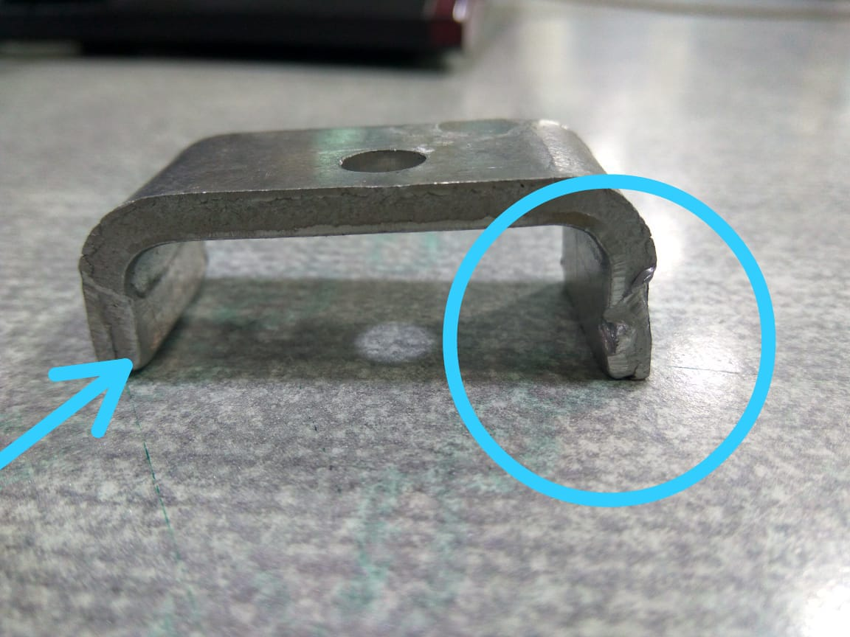
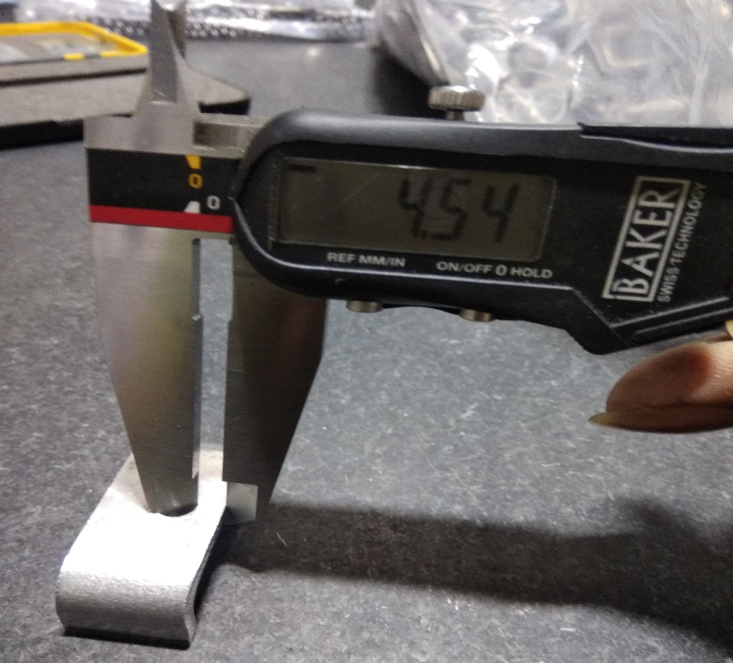
Attributes & variable
Attributes
Variable
In the ‘C’ Bracket visual inspection there is burr observed at both end of bracket we judge them according to its appearance
During the inspection of ‘C’ Bracket we check the edge to hole distance which should be within a range of 3.60-4.20
According to given tolerance we inspect them

Slide 5
Attributes & variable
Sr. No. | Part | Attributes | Variables
1 | Cap | mark | length
 |  | eccentricity | Cap ID
 |  | Flashes | Cap OD
 |  |  | Collar OD
 |  |  | Hardness

Slide 6
Attributes & variable
Sr. No. | Part | Attributes | Variables
2 | Corrugated box | Pasting | Length of Box
 |  |  | Width of Box
 |  |  | Height of box
 |  |  | Moisture contained
 |  |  | BS of the box

Slide 7
Attributes & variable
Sr. No. | Part | Attributes | Variables
3 | joint | glue mark | Length of joint
 |  | Burr on joint | Spinning ID
 |  | crack mark | Spinning OD
 |  |  | Flaring ID
 |  |  | Flaring OD
 |  |  | Tube OD & ID

Slide 8
Attributes & variable
Sr. No. | Part | Attributes | Variables
4 | ‘C’ Bracket | burr | Hole to edge distance
 |  | cutter mark | Hole shifting
 |  |  | Edge side length
 |  |  | Total length

